Slide 1
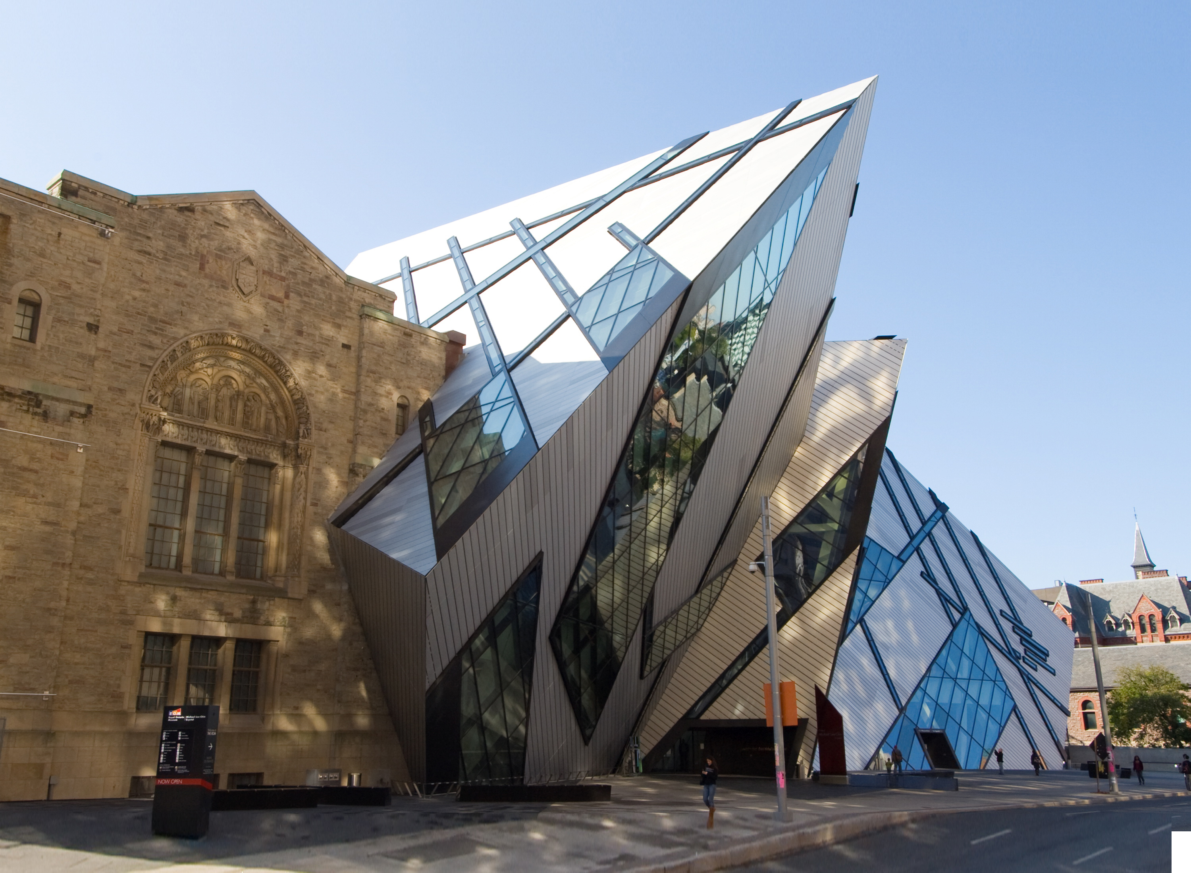
Architectural Styles
by Martin Chaov

Slide 2

Hi, I’m Martin!
Tech enthusiast
Software architect
Ex-designer
...at least for me...

Slide 3
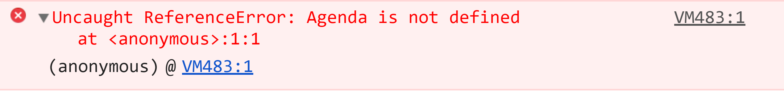
Agenda

Slide 4
Architectural Styles
Pipe-and-filter
Layered
Client-server
MVC
Message passing
Wrapper
Process control
Cloud patterns

Slide 5
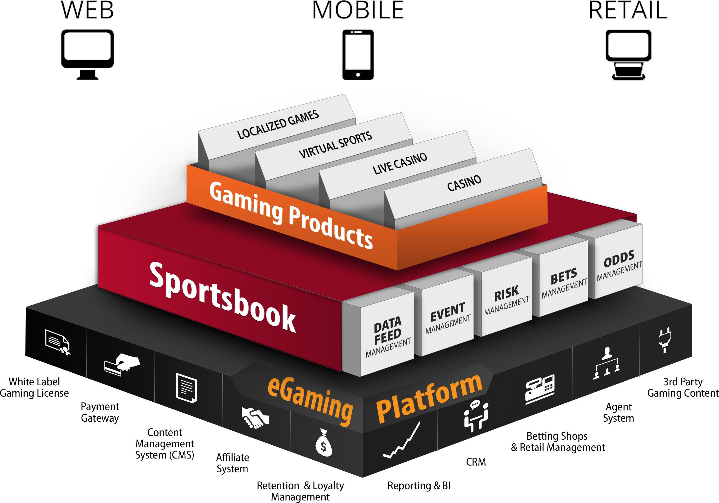

Slide 6
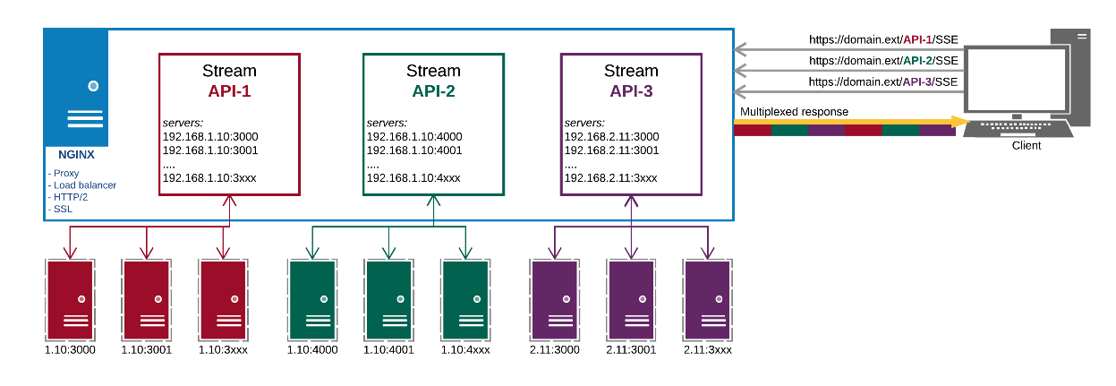
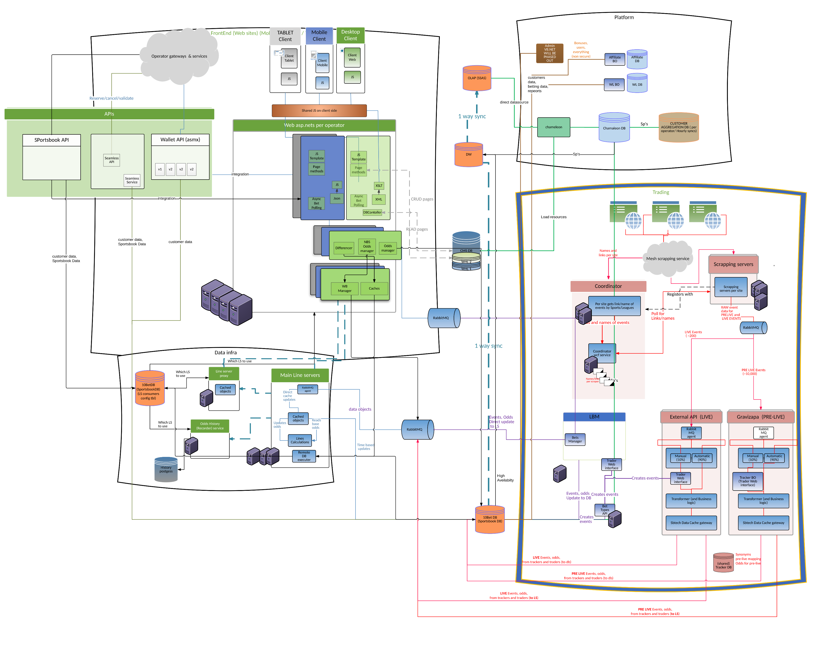
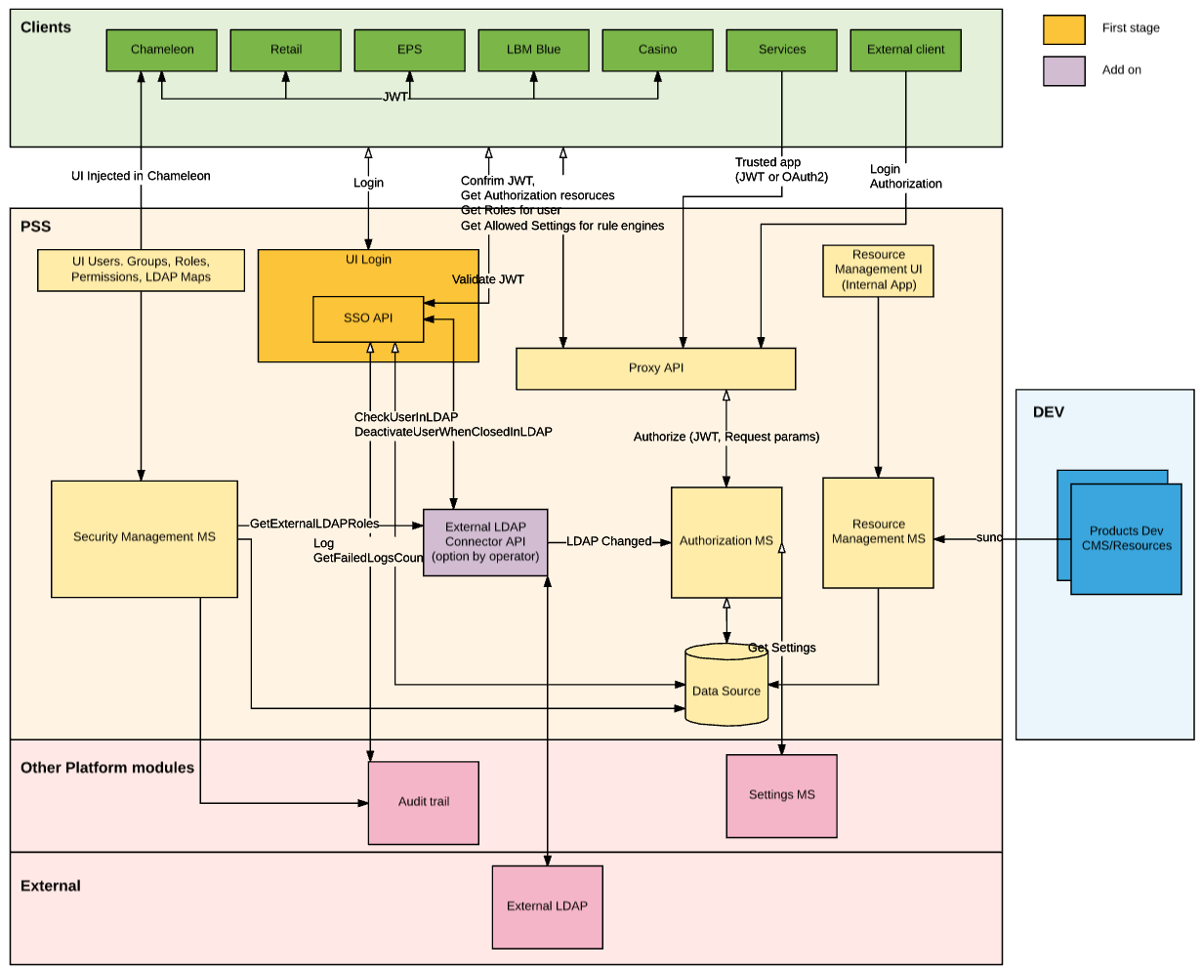
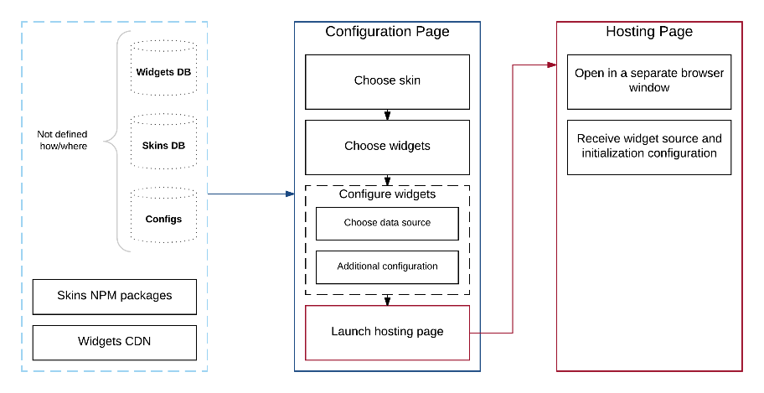
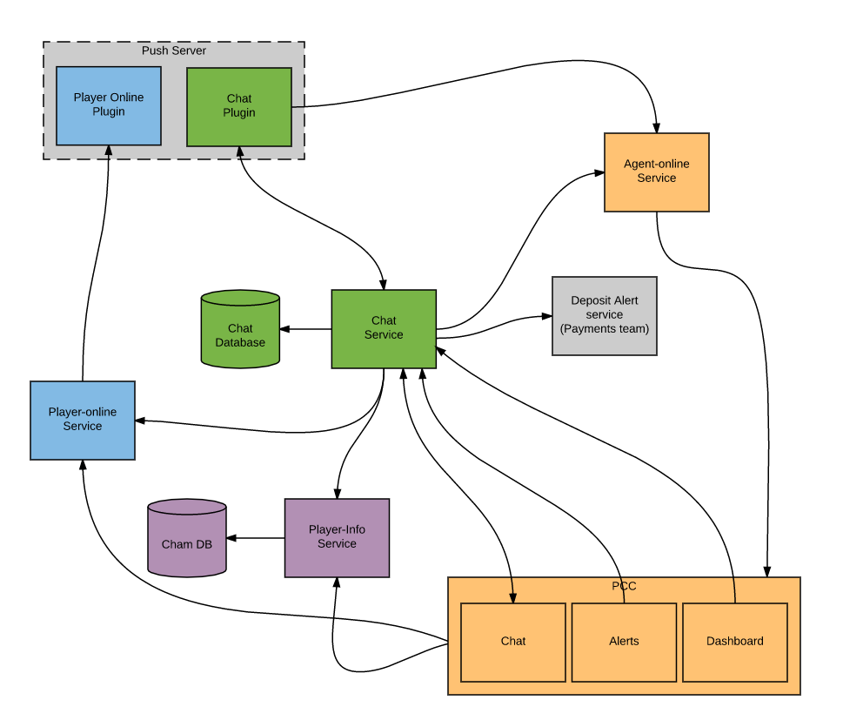
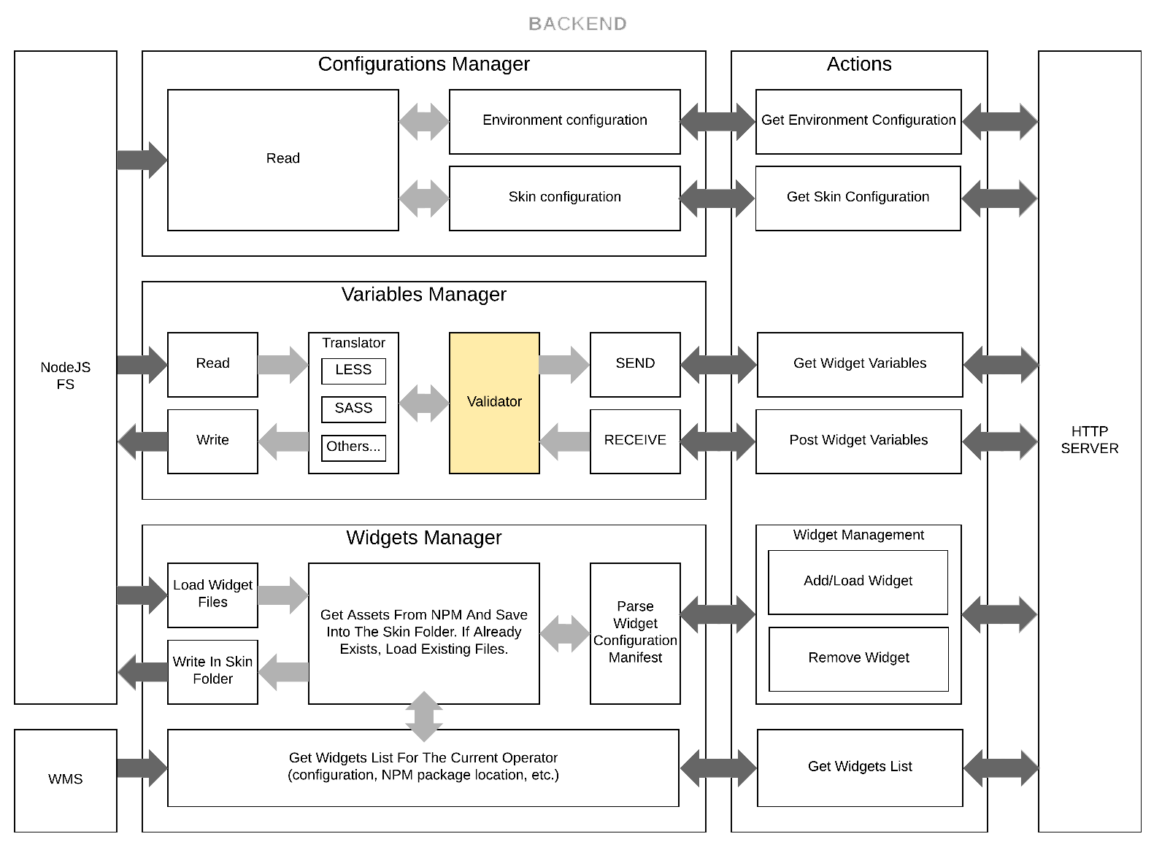
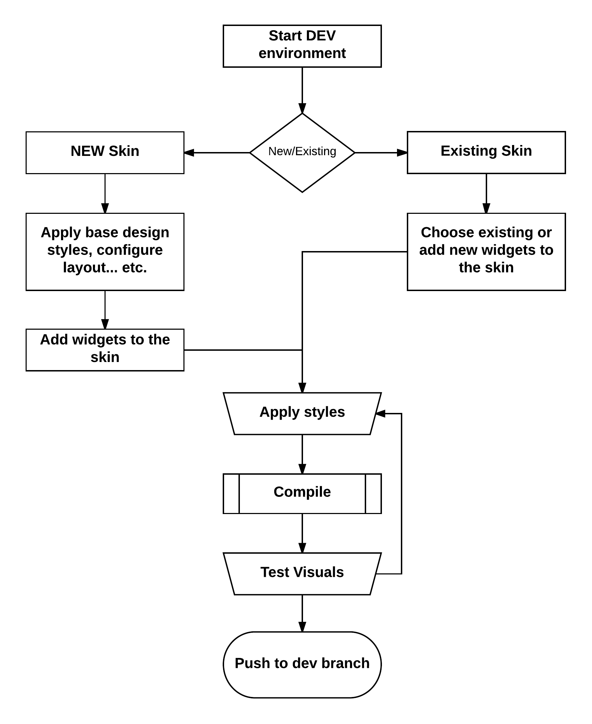
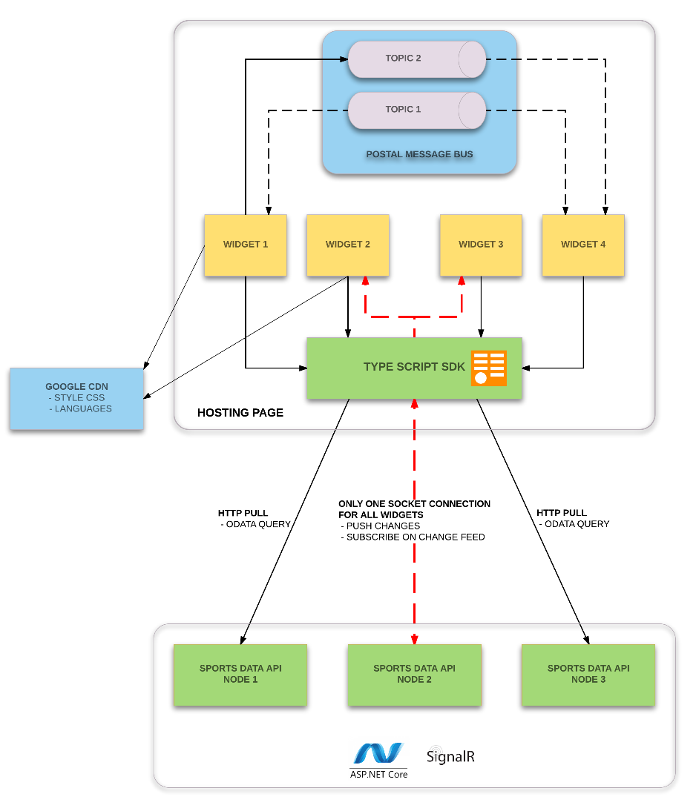
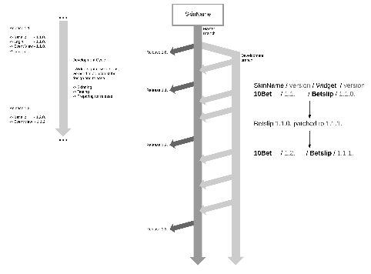
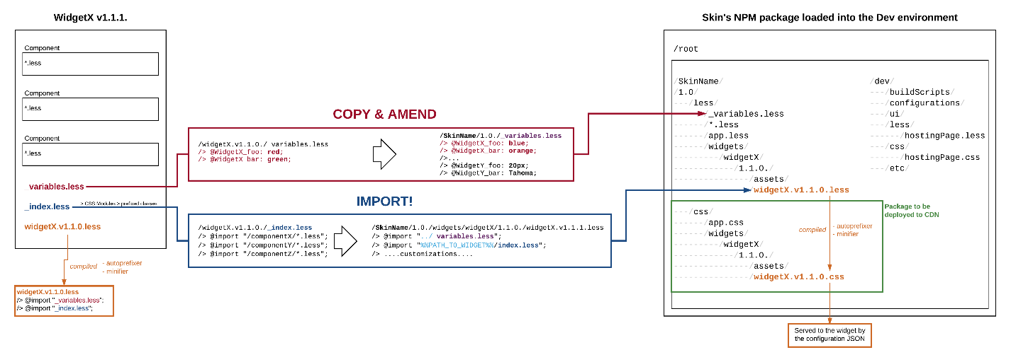

Slide 7
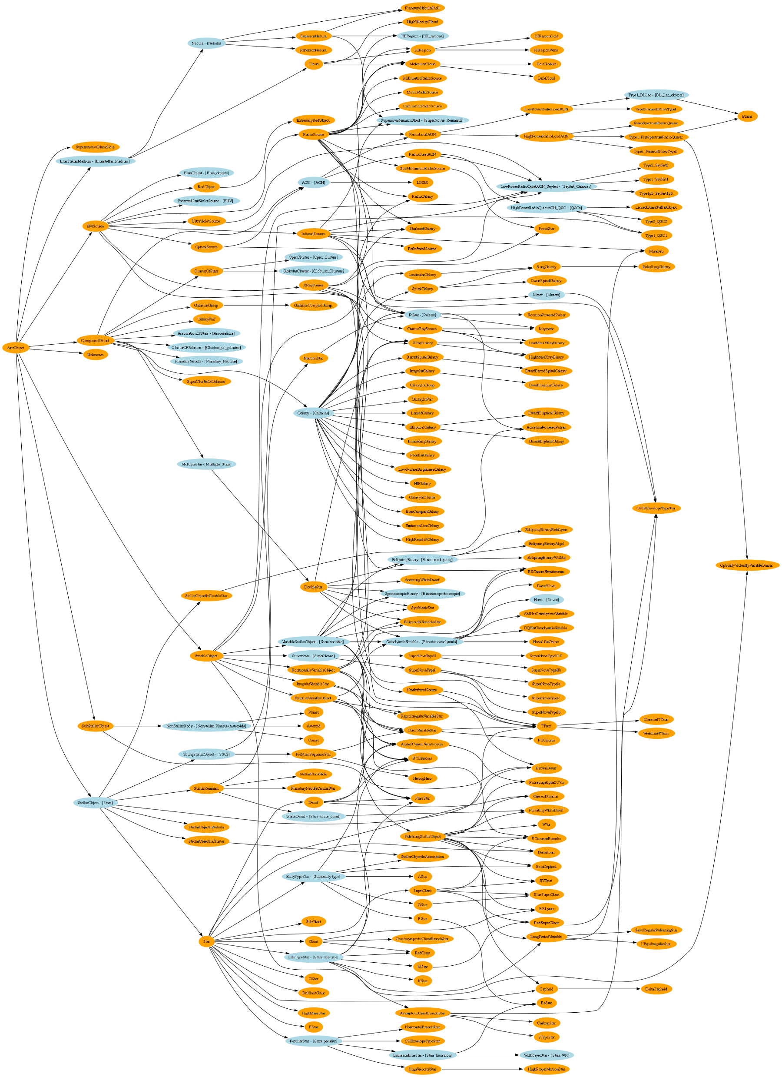

Slide 8
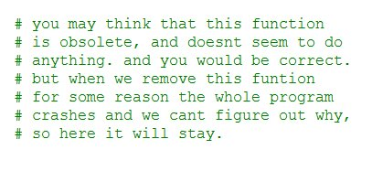

Slide 9
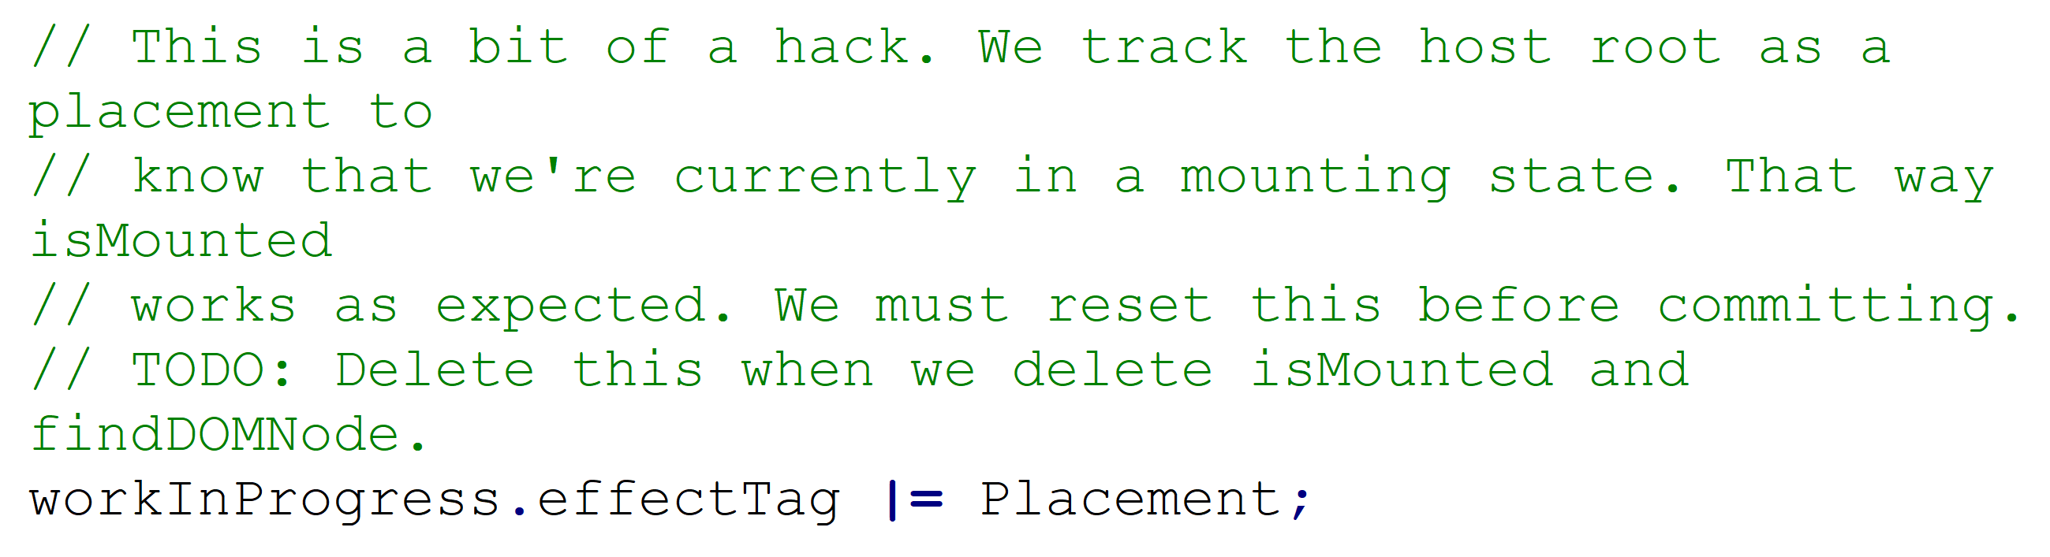

Slide 10
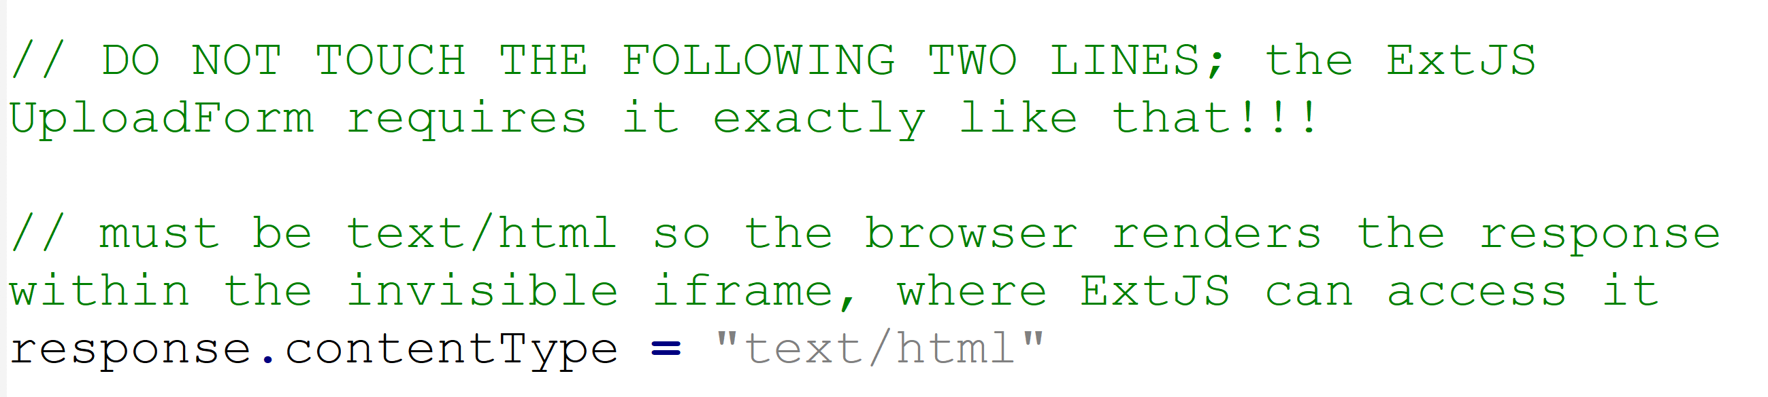

Slide 11
DDD

Slide 12


Slide 13


Slide 14
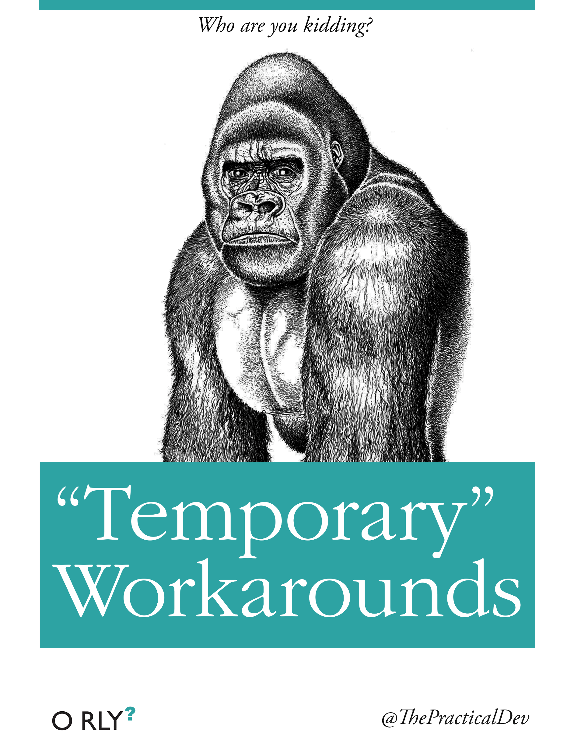

Slide 15
CCP

Slide 16
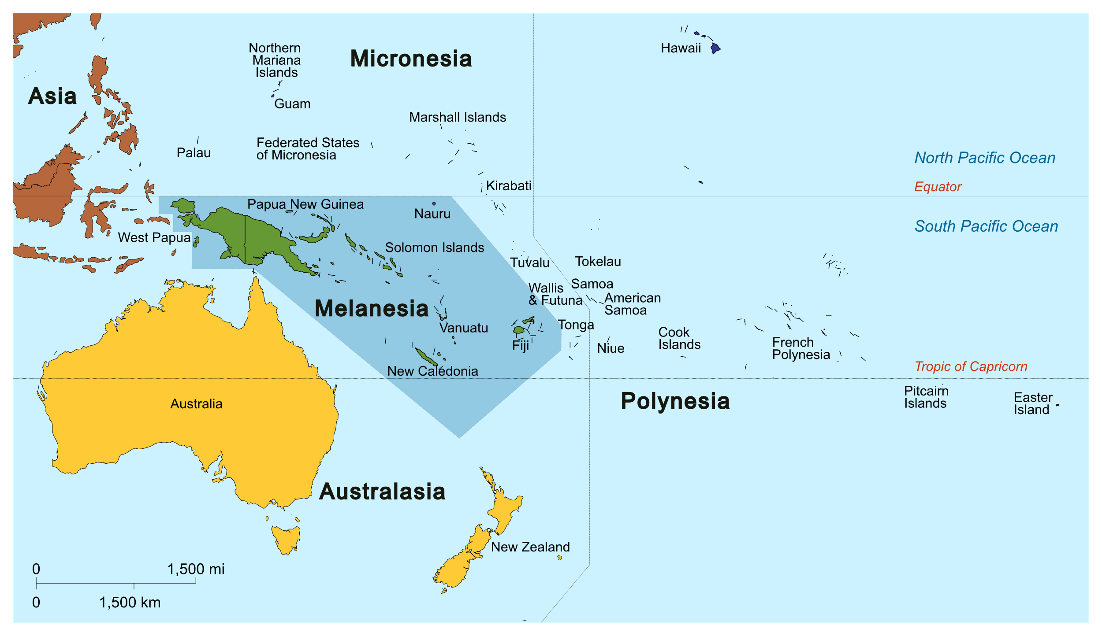

Slide 17


Slide 18


Slide 19
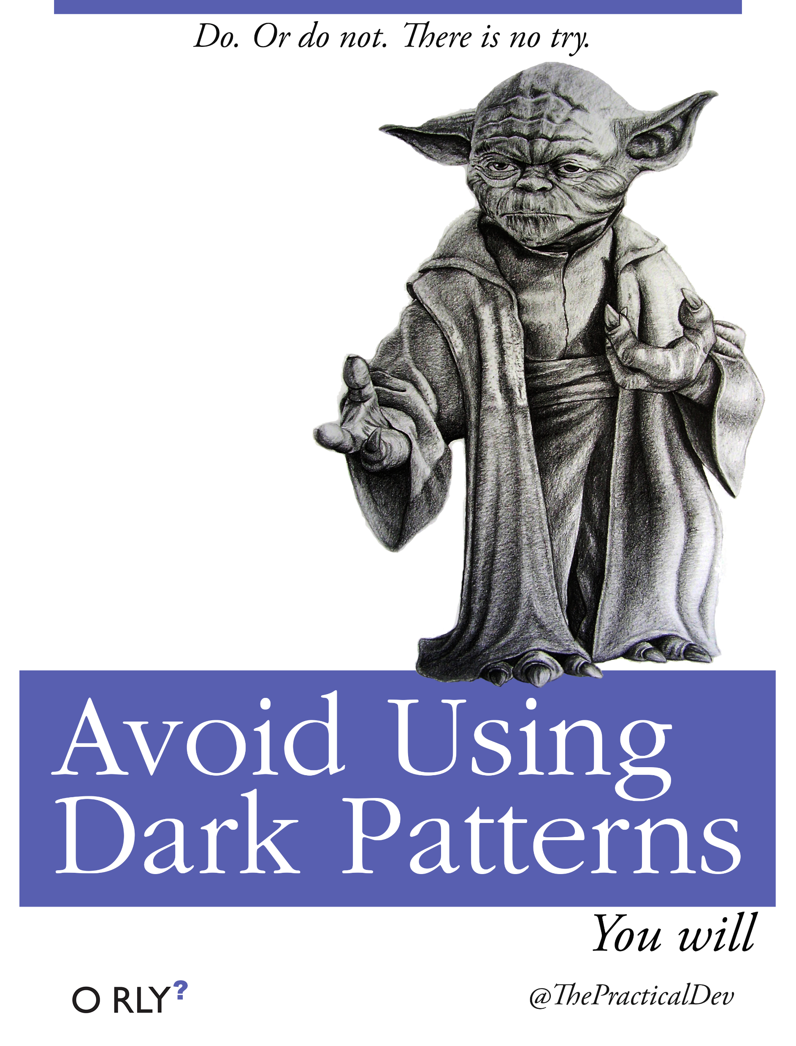

Slide 20
FDD

Slide 21


Slide 22


Slide 23


Slide 24
PCP

Slide 25


Slide 26


Slide 27


Slide 28
HDD

Slide 29


Slide 30


Slide 31
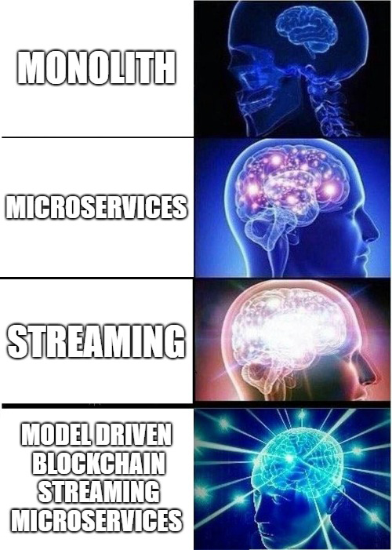

Slide 32
HRDD

Slide 33


Slide 34
SDD

Slide 35


Slide 36


Slide 37

REAL PROGRAMMERS
don’t
COMMENT THEIR CODE
If it was hard to write
It must be hard to read

Slide 38

Lets play a game...

Slide 39
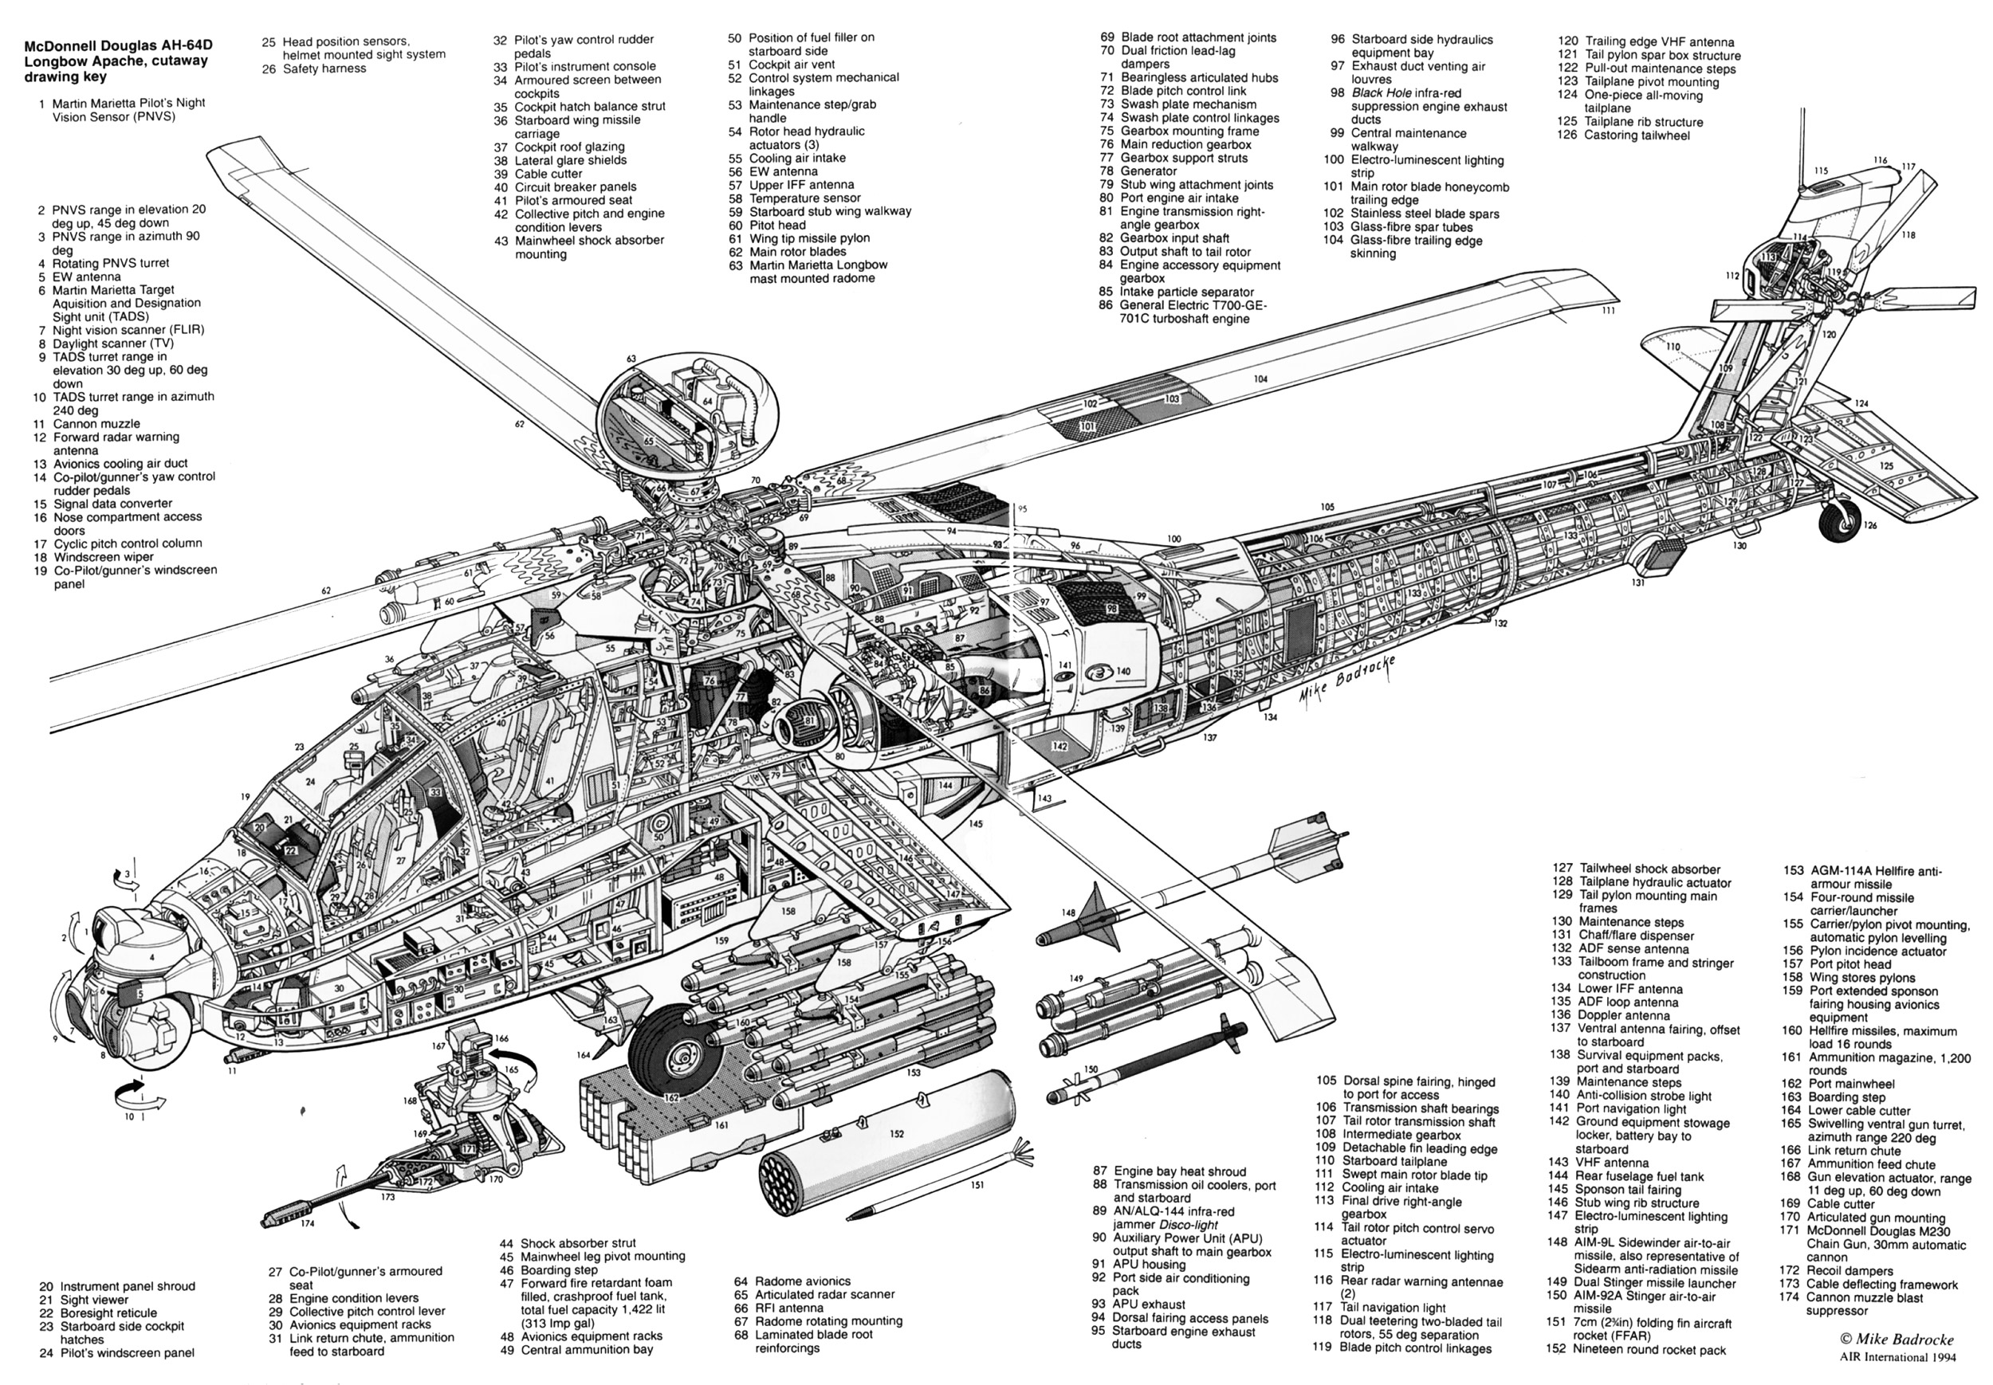

Slide 40
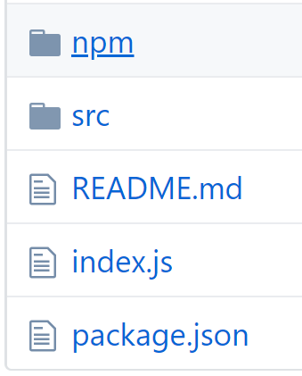

Slide 41
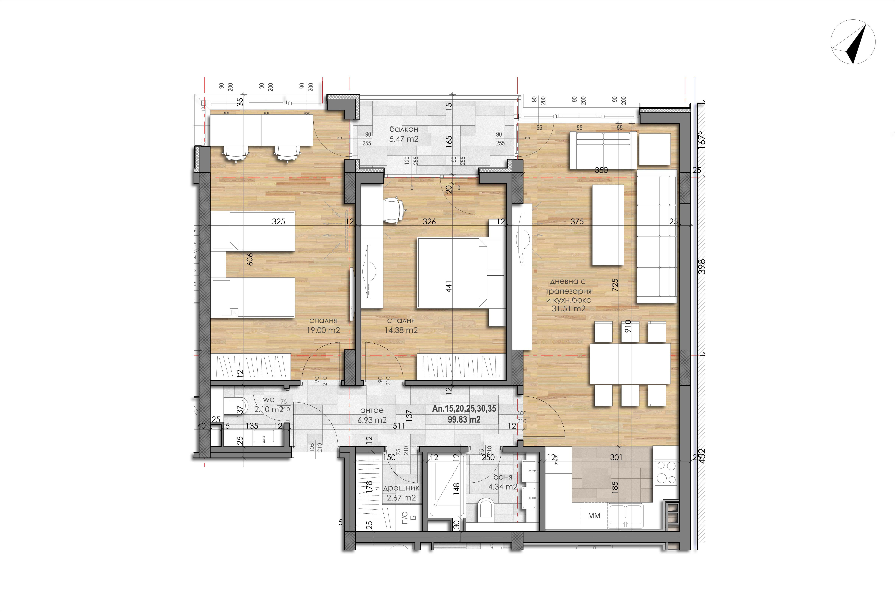

Slide 42
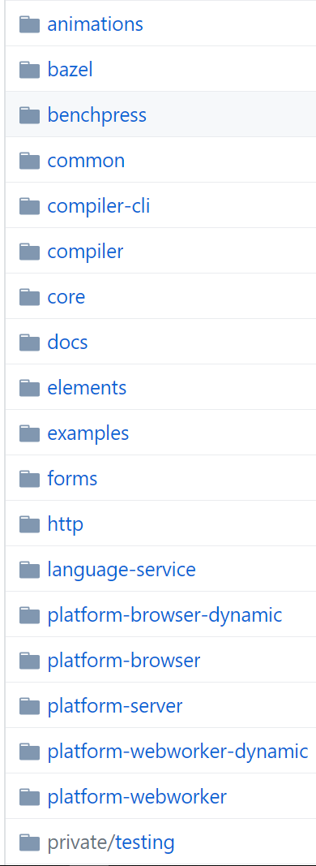
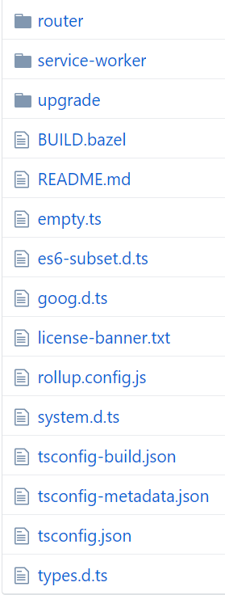

Slide 43
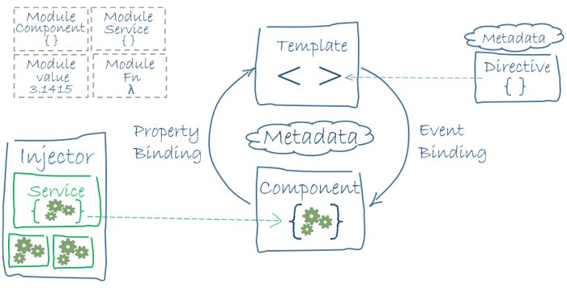

Slide 44
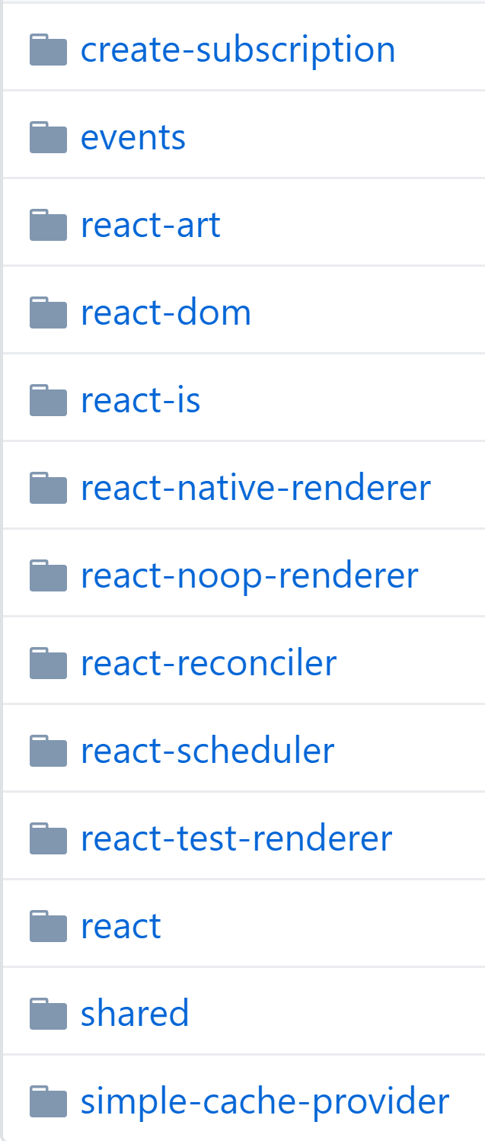

Slide 45
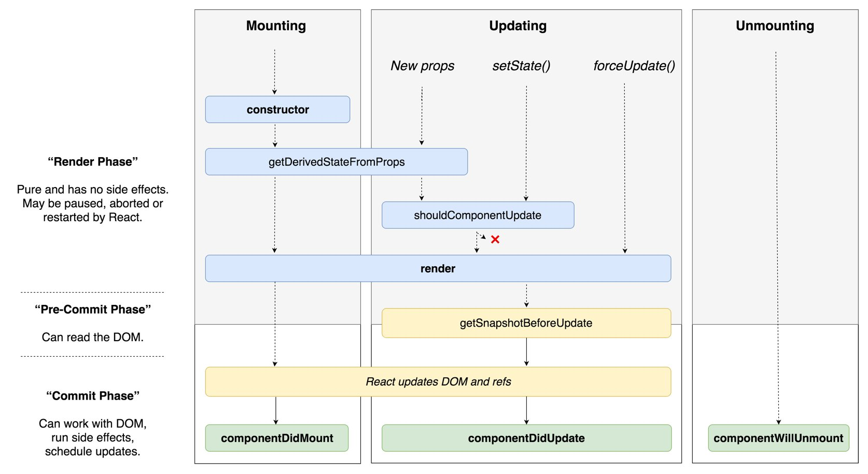

Slide 46
Where is the problem coming from?

Slide 47




Slide 48
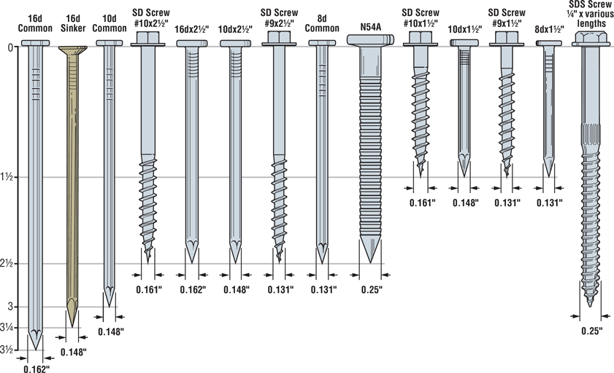

Slide 49
JS Solution architecture?

Slide 50
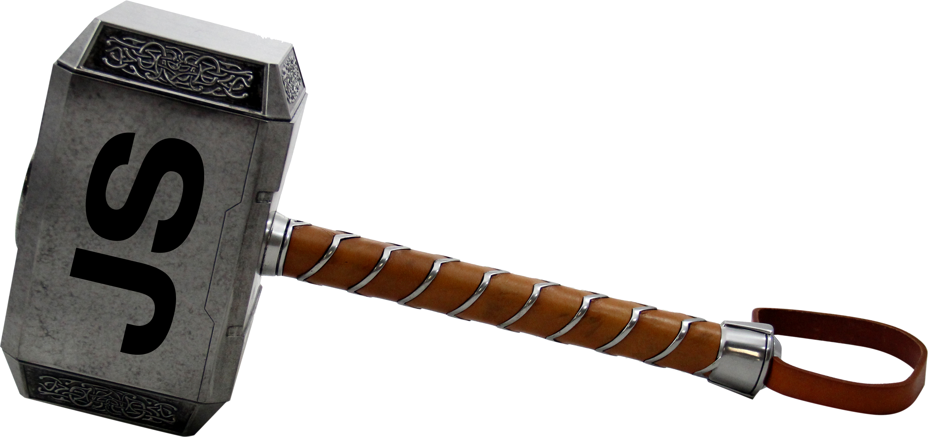

Slide 51
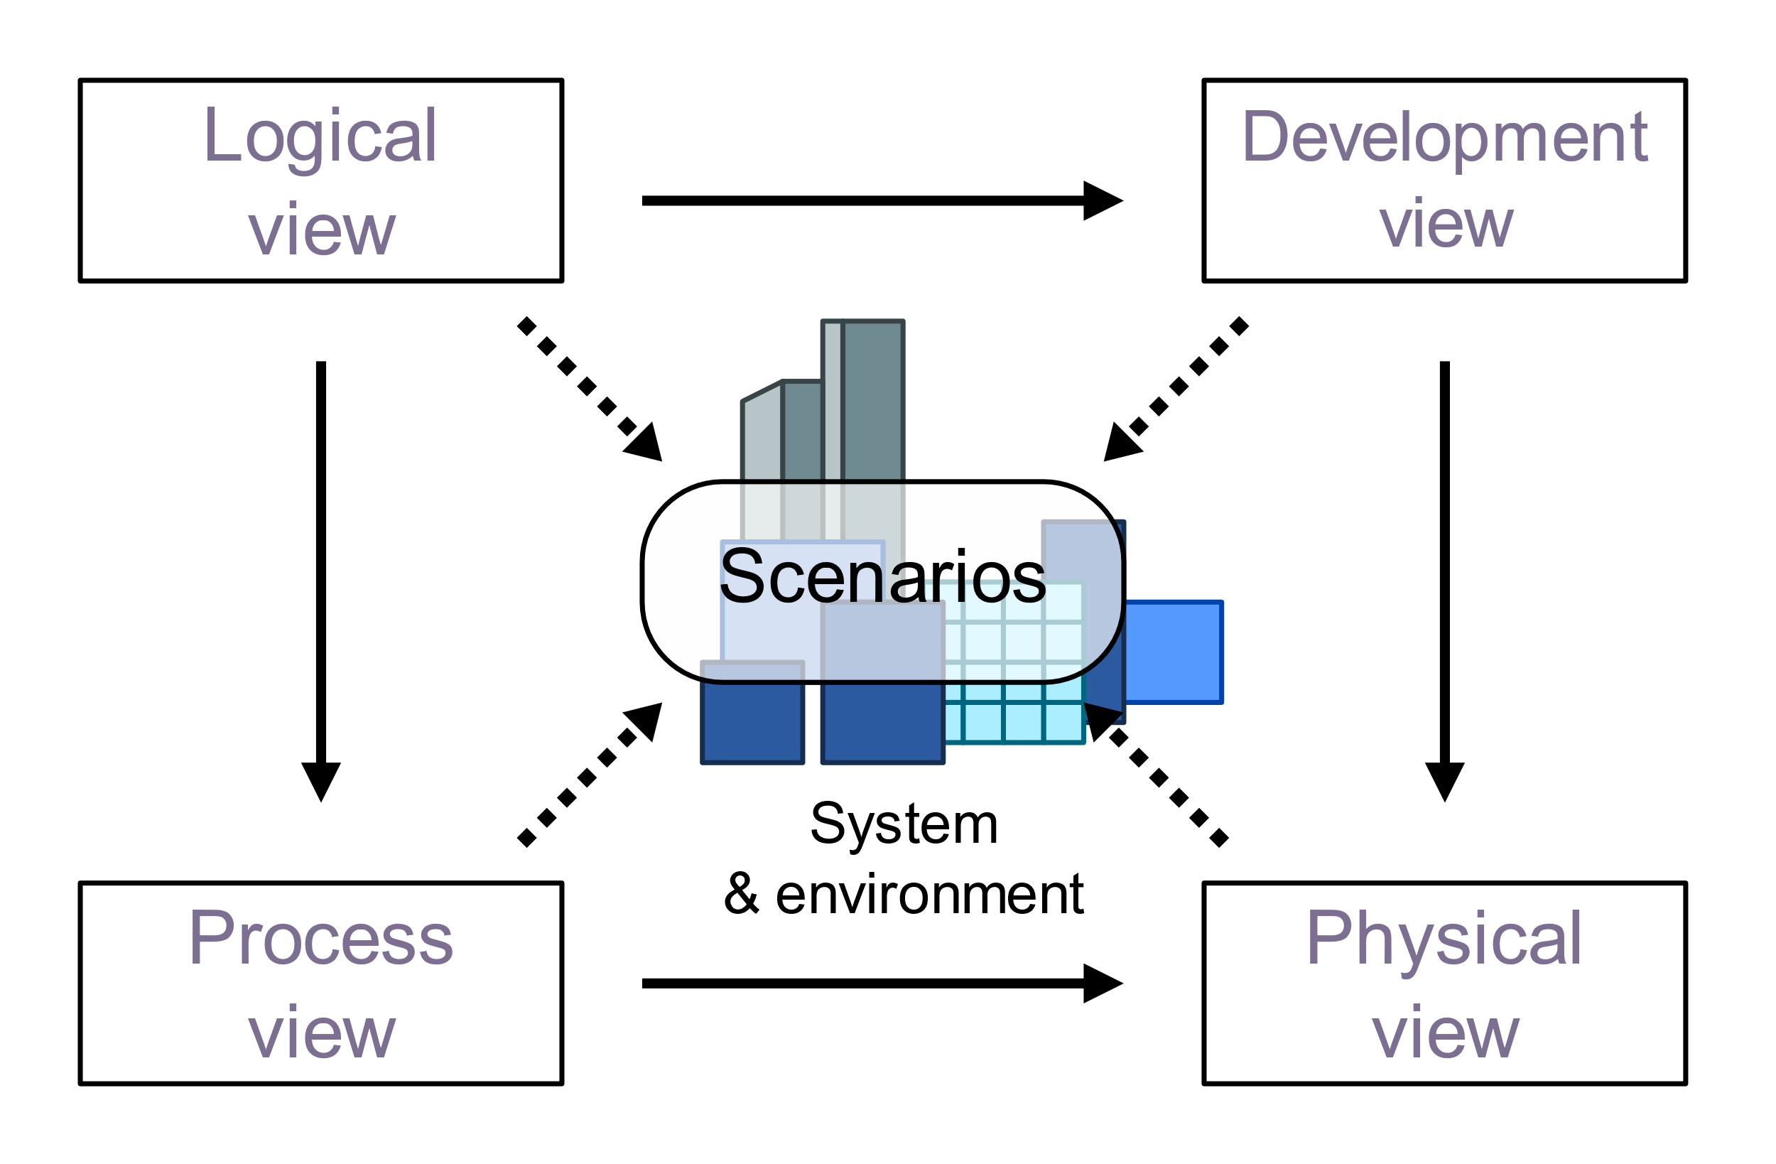

Slide 52
Conway’s law…

Slide 53
ES3
ESNEXT

Slide 54
Summary

Slide 55


Slide 56

Connect ☺
LinkedIn: https://goo.gl/CRRJ2Y
Mail: martin.c@sbtech.com
Github: https://github.com/mchaov
@raziel_pld

